Slide 1
REPOSITORY PATTERN
A patterns-box talk
by
Miguel Salas

Slide 2
About me
Hi, I’m Miguel, Software Engineer at Belatrix. Currently working at La Seleccion Team developing Connovus innovation project

Slide 3
01
02
03
04
Goal
Real world case
Architecture
Problems it solves

Slide 4
05
06
07
08
When to use it?
When not to use it?
Common mistakes
Advantages and Drawbacks

Slide 5

Goals
Hide data access complexity
Increase developer productivity
Notes:
Make the data appear as if it is just living inside an in memory collection so at business or higher layers it’s unaware of the data access complexity.

Slide 6





Real world case

Slide 7
Architecture
Business Layer
Business Layer
Repository Layer
Database
Database

Slide 8
Architecture
Business Layer
Repository Layer
Database

Slide 9

Problems it solves
Duplication of data access code
Complex migration from one data source to another
Overhead of data access code from business layer
Notes:
Duplication of data access code
Complex migration from one data source to another
Typically data access code is very repetitive and its concern with low level infrastructure details like opening sql connections and managing sql parameters and transactions.

Slide 10

When to use it?
When our application needs to access data from multiple data sources
When we want to make our business logic agnostic and decoupled from the data source implementation
When we are developing an MVP
Notes:
When our application needs to access data from multiple data sources making it prone to duplication of code.
When our business layer needs focus on those algorithms that make the business work.
When we are developing an MVP which we know will change from data source eventually.

Slide 11

When not to use it?
When we have entities for which it doesn't make sense to allow full CRUD operations
Notes:
When we have entities for which doesn't make sense to allow full CRUD operations (Can be easily solved by splitting the interface into three: One for reading, one for updating and one for deleting).

Slide 12

Common Mistakes

Slide 13
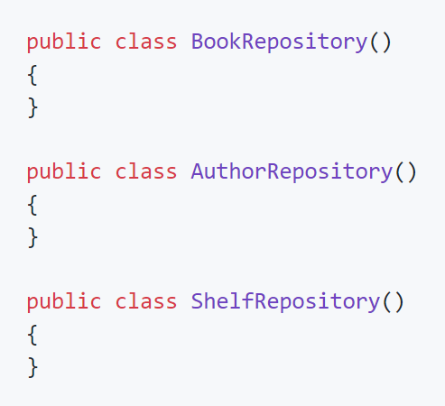

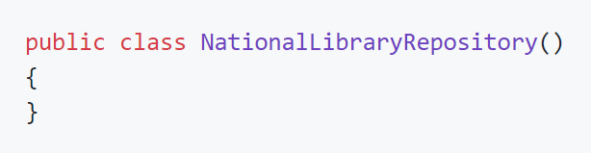

Common mistake 1: Not having one repository per domain class
Notes:
Domain class: A "domain" class is one that models your data typically store in a database.
If we have an application called "National Library", there shouldn't be a repository called:
Instead, we should have a separate repository per domain class, like BookRepository, AuthorRepository, ShelfRepository.

Slide 14
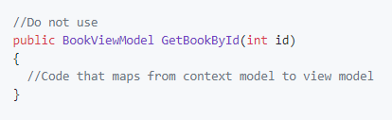
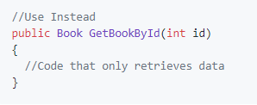
Common mistake 2: Returning view models or DTOs
Notes:
* A repository method shouldn't return view models or DTOs. Mapping a domian object into a view model/DTO should be the responsibility of a higher level layer like a Service or a Controller.

Slide 15
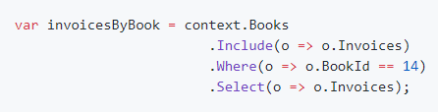
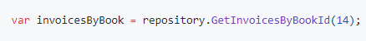
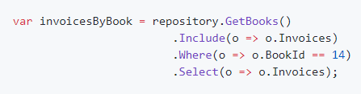
Common mistake 3: Methods that return IQueryable type
Notes:
Unless it's a private method, none of the methods on a repository should return a IQueryable type, always call ToList() or ToArray(). Take this example:
[Wrong way 1]
We are directly retrieving information from our DbContext, if our repository method returns IQueryable, someone else may compose a query on top of it, like so:
[Wrong way 2]
The only difference between these two examples is the first line were the method GetBooks is being called, so we are not solving the problem of hidding the complexity from that layer. Instead what we should have is something like this:
[Correct way]
Were GetCustomersByBook returns a list rather than a IQueryable.

Slide 16
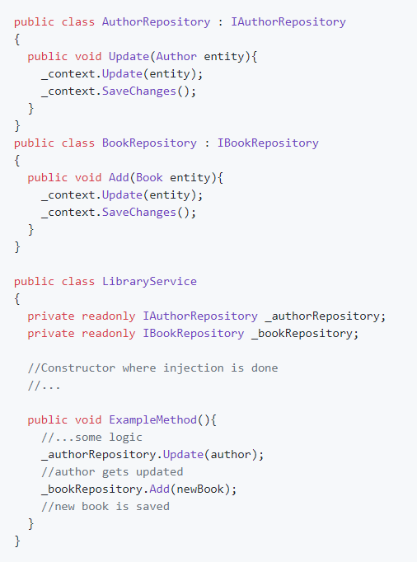
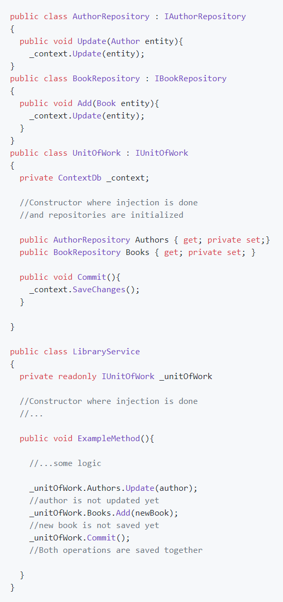
Common mistake 4: A repository shouldn’t manage transactions
Notes:
The repository is NOT responsible for managing database transactions. This concern is best managed using Unit Of Work pattern.

Slide 17
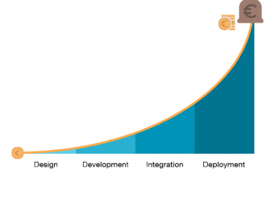
Cost of fixing software bugs
Common mistake 5: Not testing the repository
layer properly
Notes:
Every method of our repositories should be covered by one or more integration tests, which should use the same kind of DB we use in production environment.

Slide 18
Demo

Slide 19
Advantages and Drawbacks

Slide 20

Advantages
Business logic can be unit tested without data access logic.
The database access code can be reused.
It gives a substitution point for the unit tests.
Increases developer productivity.

Slide 21
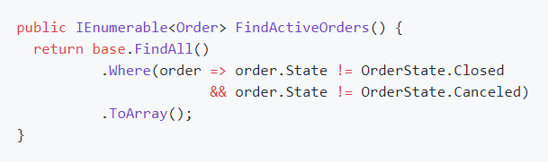
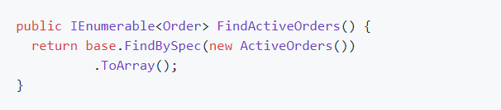
Drawback 1:
Unwanted migrations of business logic
With Specification Pattern:
Notes:
Specification patterns helps us to identify if certain object fulfil a previously defined specification, that in this case, is a business rule.

Slide 22
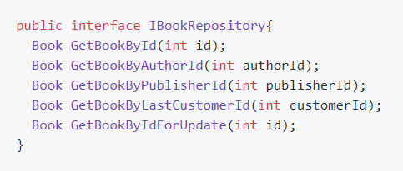
Drawback 2: Accumulation of very similar Find methods
Can be solved with:
Query Object Pattern
Builder Pattern
CQRS Pattern (for bigger repositories)
Notes:
Query Object Pattern or the Builder Pattern or, for bigger repositories, CQRS Pattern.

Slide 23

Thanks

